Slide 1
529 Data Analytics
October 19, 2016
Chicago Transit Authority (CTA) Ridership Analysis
Balaji Selvarajan

Slide 2
Table of Content
CTA Facts ----------------------------------------------------------------------------------------------- 3
Business Scenario ----------------------------------------------------------------------------------- 4
Business Objective ---------------------------------------------------------------------------------- 5
Selected Data ------------------------------------------------------------------------------------------ 6
Processing Steps ------------------------------------------------------------------------------------- 7
Variable Information ------------------------------------------------------------------------------ 8
Exploratory Data Analysis 1 ------------------------------------------------------------------- 9
Exploratory Data Analysis 2 ------------------------------------------------------------------- 10
Regression Modeling 1 ---------------------------------------------------------------------------- 11
Regression Modeling 2 ---------------------------------------------------------------------------- 13
Conclusion ---------------------------------------------------------------------------------------------- 15

Slide 3
Chicago Transit Authority (CTA) Facts
CTA is the second largest public transport system in the United States.
CTA has 1,888 buses that operate 130 routes and serve 10,813 bus stops.
On the rail system, CTA has 1,492 rails cars that operate eight routes and serve 145 stations.
CTA’s rail system is referred to as “L” because most of the rail lines are elevated above the city streets.
On an average weekday (2005) 1.64 million passengers uses CTA (Including buses and trains).
Chicago was one of the few cities which has public transportation to both major airports.

Slide 4
Business Scenario
Chicago Transit Authority (CTA) operates the country’s second biggest public transport system and has spread across the City of Chicago and 35 surrounding suburbs.
CTA wants to effectively route their bus and rail system by minimizing and maximizing the count of buses and rail cars.
For this, CTA has decided to build a model that would predict the passenger counts depending upon the weather forecast, holidays and seasons. This can be done by analyzing the CTA ridership and weather dataset.

Slide 5
Business Objective
Using the CTA’s bus and rail ridership information and weather dataset, we are going to study the increase and decrease in ridership count which is influenced by temperature, season and day type (weekday, Saturday and Sunday/ Holiday).
What is the difference in the percentage of ridership count on a weekday, Saturday and Sunday/holiday?
What percentage increase in ridership count is expected in summer compared to winter at Midway and O’Hare airports?

Slide 6
Selected Data CTA Ridership and Weather Data Details
Time period of the below datasets are 15 Years (From 2001 to 2015)
Datasets are collected from the below URLs.
NOTE: Weather data was collected for each year and concatenated to form 15 years data
URL | OBS | VARIABLES
https://data.cityofchicago.org/Transportation/CTA-Ridership-Bus-Routes-Daily-Totals-by-Route/jyb9-n7fm | 676,476 | 4
https://data.cityofchicago.org/Transportation/CTA-Ridership-L-Station-Entries-Daily-Totals/5neh-572f | 778,654 | 5
https://www.wunderground.com/history/airport/KMDW/2016/9/15/CustomHistory.html?req_city=Chicago&req_state=IL&req_statename=Illinois&reqdb.zip=60290&reqdb.magic=1&reqdb.wmo=99999 | 5,478 | 24

Slide 7
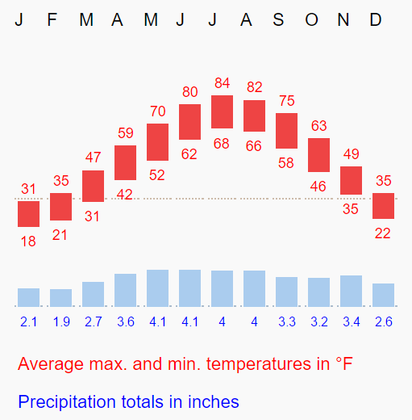
Processing Step
In CTA dataset, variables like season, month, and year are derived from the information that are available on the dataset.
Example, from date variable (Available on both the CTA datasets), year and month variables are derived.
Also, from month variable and temperature information (Figure 1), season variable is derived.
Autumn, Spring, Summer, and Winter are the four different season which is used for the analysis.
Figure 1 : Temperature Data
Source : NOAA

Slide 8
Variable Information
Depending on the values, data in the datasets can be grouped into categorical and continuous data.
Variables in Y- Axis are called as Response variables and variables in X-axis are called as Predictor variables.
 | X-AXIS | Y-AXIS
CATEGORICAL | DAY_TYPE
 | SEASON
 | YEAR
CONTINUOUS |  | TOTAL_RIDES
 |  | RAIL_BOARDINGS

Slide 9
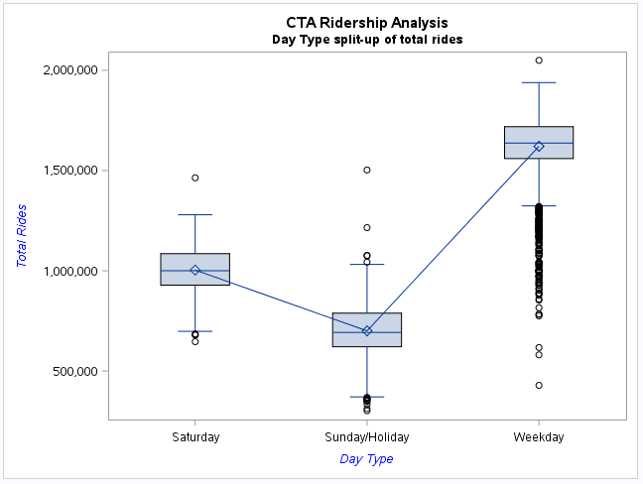
Exploratory Data Analysis 1 Day Type split-up of total ride count
Ridership count varies depending on whether it is a weekday, Saturday and Sunday/holiday. Mean value differs for the predictor variable (Day Type) when plotted against the response variable (Total Rides).

Slide 10
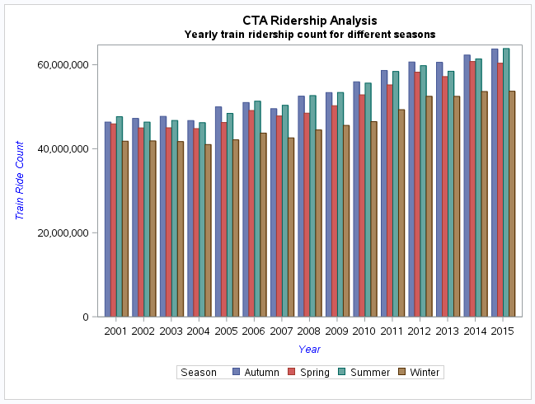
Exploratory Data Analysis 2 Yearly train ridership count for each season
Every year, train ridership count tends to increase gradually. During the extreme weather condition (Summer and Winter season), there is a drastic change in the ridership count.

Slide 11
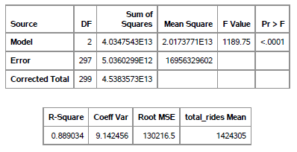
Regression Modeling 1 Model fit check - Ride Count Vs Day Type
What is the difference in the percentage of ridership count on a weekday, Saturday and Sunday/holiday?
p-value (<.0001) is less than 0.05, so we reject the null hypothesis.
R² value is 0.889034, so day type explains about 88% of the variability of total ride count.

Slide 12
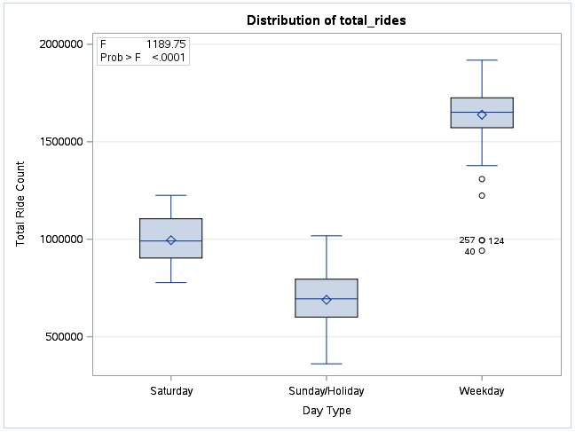
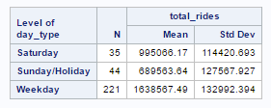
Regression Modeling 1 Analysis - Ride Count Vs Day Type
Percentage of the ridership count is being derived from the frequency and mean value of each day type.
85% of the people use the public transport during the weekdays and 8% during the Saturday and 7% during the Sunday/Holiday.

Slide 13
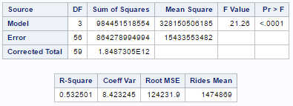
Regression Modeling 2 Model fit check – Train Rides Vs Seasons
What percentage increase in ridership count is expected in summer compared to winter at Midway and O’Hare airports?
p-value (<.0001) is less than 0.05, so we reject the null hypothesis.
R² value is 0.532501, so season explains about 53% of the variability of train rides from the airports.

Slide 14
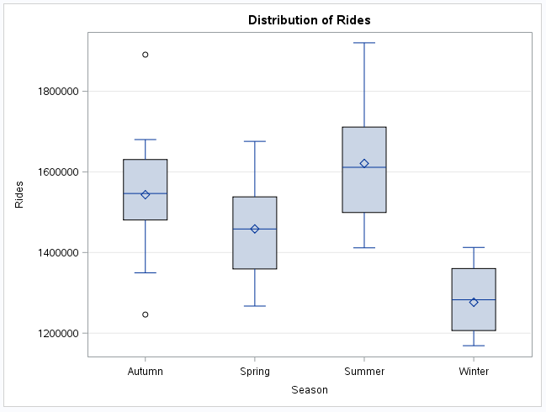
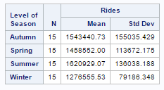
Regression Modeling 2 Analysis – Train Rides Vs Seasons
Below are the ridership mean values from Midway and O’Hare Airports. When compared to Winter, we could expect a 21% increase in ridership count for Summer season.

Slide 15
Conclusion
Exploratory and Regression analysis was performed to determine the relationship between temperature and ridership count. Below are few findings from the analysis.
As the temperature increases, the ride count also increases.
In the recent years, train ride count is gradually increasing and bus ridership count is decreasing. This clearly shows that, passengers are moving towards the rail system.
Riders prefer the transit mode that aren’t impacted by traffic jams and also the weather protected stations.
Weather plays a major role in determining the ridership count.

